Slide 1
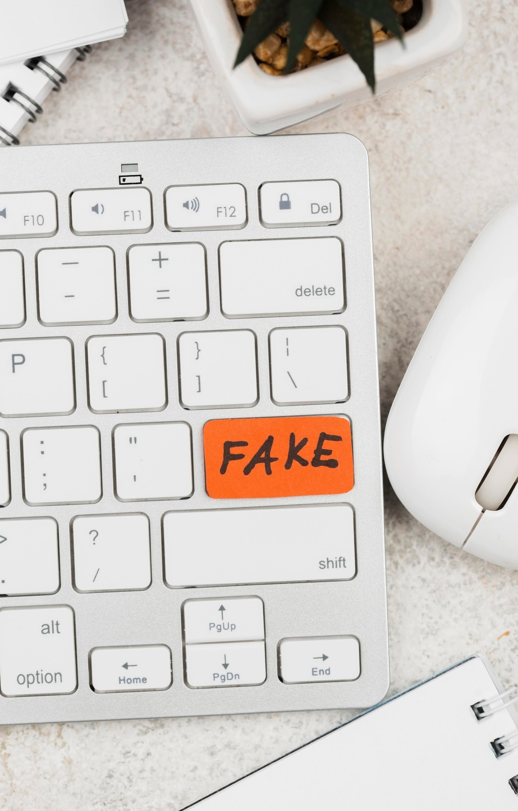
Keyloggers
Presented by Mahalakshmi. M
BE/CSE
Grace College Of Engineering

Slide 2
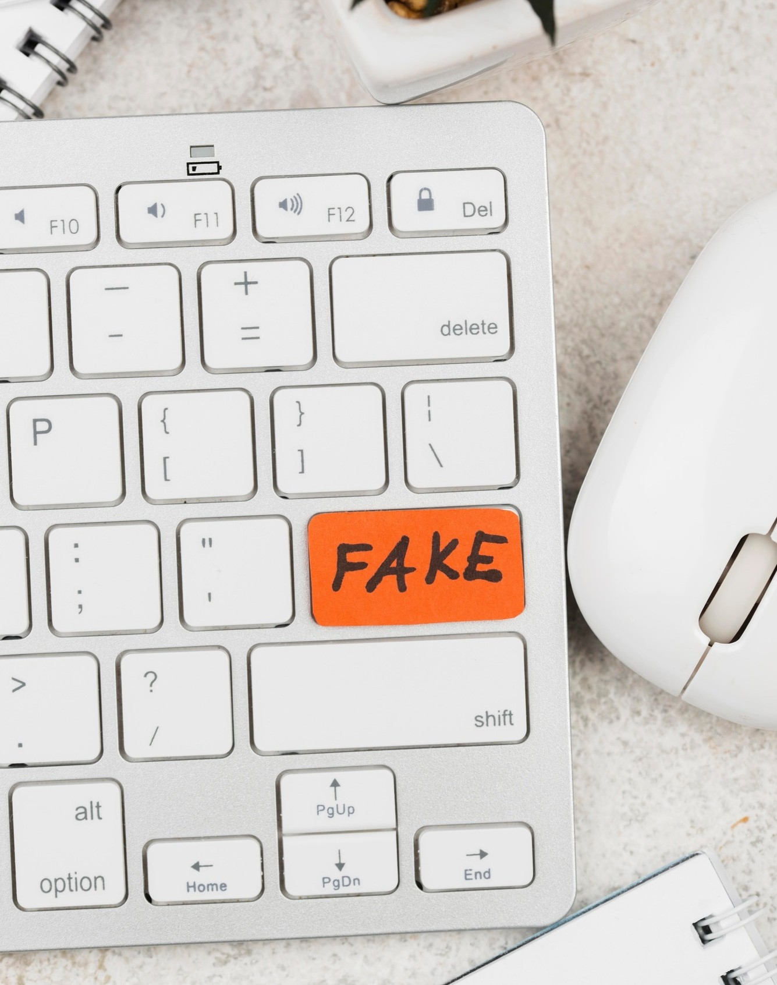

Introduction
This presentation will provide a professional overview of keyloggers and their potential threats. We will discuss the methods to safeguard against unauthorized access and protect sensitive information.

Slide 3



What are Keyloggers?
Keyloggers are malicious programs designed to record keystrokes on a computer. They can capture sensitive information such as passwords, credit card numbers, and personal messages, posing a signiﬁcant security risk.

Slide 4



Types of Keyloggers
There are two main types of keyloggers: hardware-based and software-based. Hardware keyloggers are physical devices attached to the computer, while software keyloggers are installed as malware on the system.

Slide 5
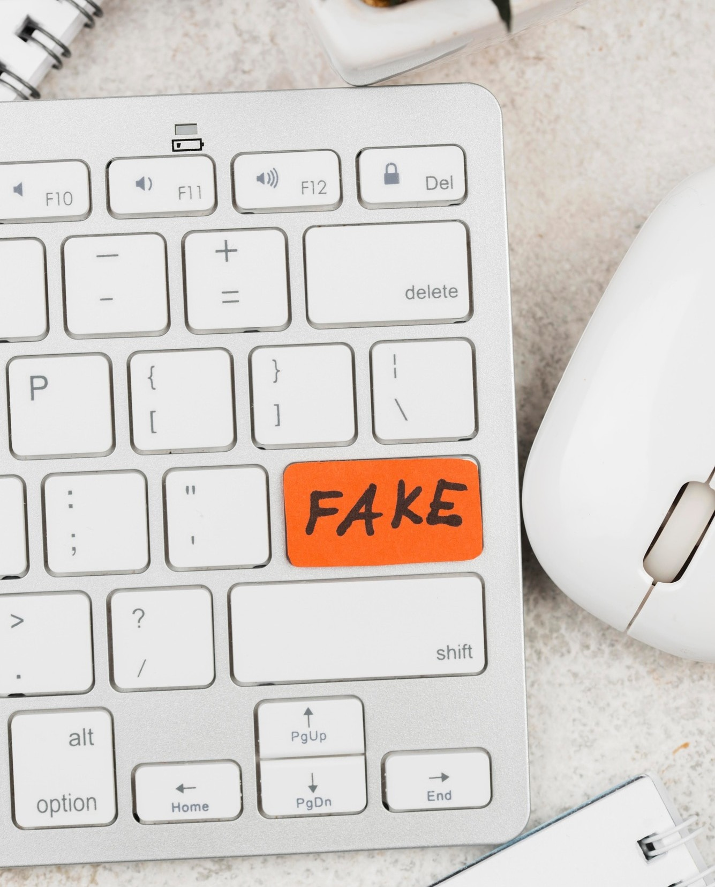




Common Entry Points
Keyloggers can enter a system through phishing emails, infected websites, or removable devices. It is crucial to be vigilant and employ security measures to prevent unauthorized access.

Slide 6







Detecting Keyloggers
Detecting keyloggers can be challenging as they often operate silently. Regularly scanning for malware, monitoring system performance, and using security software are essential for detection.

Slide 7
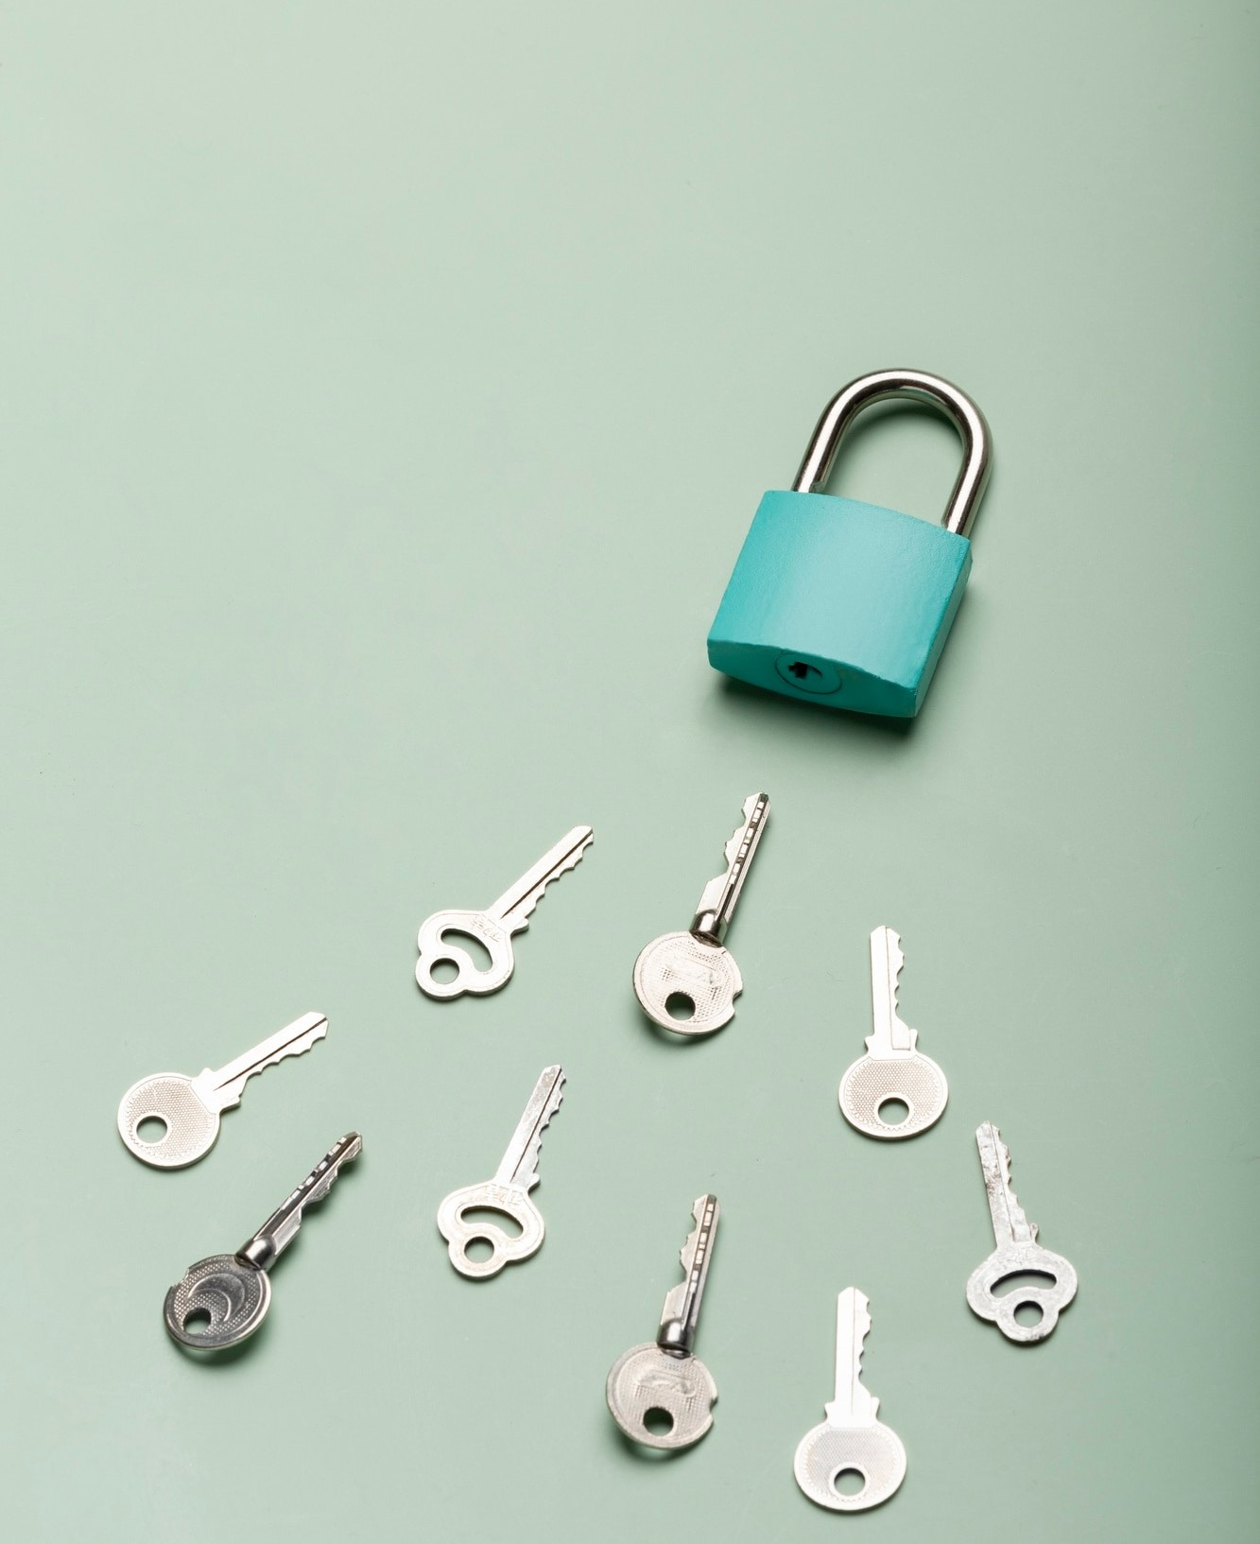




Safeguarding Against Keyloggers
Implementing strong passwords, using two-factor authentication, and regularly updating security software are effective measures to safeguard against keyloggers. Additionally, encrypting sensitive data adds an extra layer of protection.

Slide 8



Best Practices for Security
Educating employees about cybersecurity best practices, conducting regular security audits, and establishing clear security policies are crucial for maintaining a secure environment and safeguarding against unauthorized access.

Slide 9

Conclusion
In conclusion, understanding keyloggers and their potential threats is essential for safeguarding against unauthorized access. By implementing robust security measures and staying vigilant, individuals and organizations can mitigate the risks posed by keyloggers.

Slide 10
Thanks!

